Slide 1
Assignment2
Pass I – Macro processor
( JAVA / Python / C++)
( Implement in language other than what you have used in LPCC Assignment 1)

Slide 2
LPCC Lab Assignment 2
Statement:
Design suitable data structures & implement pass-I of a two-pass Macro processor
Duration : WEEK1: Practice Task WEEK2: Code for input Sample 1 WEEK3: Code for input Sample 2

Slide 3
SCOPE
Macro Processor (PASS –I Only)
Input code will have macros with parameters, and nested macro calls
Nested Macro Calls will be only upto 1 level
i.e. no call within call
Also, input will not have nested macro definitions

Slide 4
Assign2: WEEK1
(Input has macro with no parameters, and no nested calls)

Slide 5
Java Practice (if Java selected) – in Week1
Open a text file and print its contents - line by line
Open a text file. Search for “MACRO” in the line. If “MACRO” is in that line, then do not print it. Else print the line
Open a text file. Copy its contents into another file, line-by-line and print that file.
Open a text file. Search for “MACRO” in the line. If “MACRO” is in that line, then do not copy the line in the output file. Else copy the line in the output file
Open a text file. Search for “MACRO” in the line. If “MACRO” is in that line, print the next word after “MACRO”
……..

Slide 6
A2: WEEK1 – Practice Task
Given an input file (Next slide)
Perform Pass – I on the given file, by Scanning it and correctly filling the
MNT
MDT
Intermediate Code(IC) (output file)
Print the above 3 things generated - MNT, MDT and the Output File IC

Slide 7
(Simple) Example1 : No NESTED MACRO CALLS / No Parameters (for PRACTICE only- TRY it OUT)
//INPUT
MACRO ADDS
MOVER AREG, =‘1’
ADD AREG,=‘2’
MOVEM AREG, X
MEND
MACRO SUBS
MOVER BREG, X
SUB BREG, Y
MOVEM BREG,X
WRITE Y
MEND
START 200
READ N1
READ N2
ADDS
SUBS
N1 DS 2
N2 DS 2
N3 DS 2
N4 DS 2
END
PASS1 – Input-Output
PASS1 TASK
STORE the MACROS in MNT, MDT
MDT
MOVER AREG, =‘1’
ADD AREG,=‘2’
MOVEM AREG, X
MEND
MOVER BREG, X
SUB BREG, Y
MOVEM BREG,X
WRITE Y
MEND
0
1
2
3
4
5
6
7
8
MNT
Macro Name | MDT Pointer
ADDS | 0
SUBS | 4
///OUTPUT file – Intermediate code IC
START 200
READ N1
READ N2
ADDS
SUBS
N1 DS 2
N2 DS 2
N3 DS 2
N4 DS 2
END
0
1

Slide 8
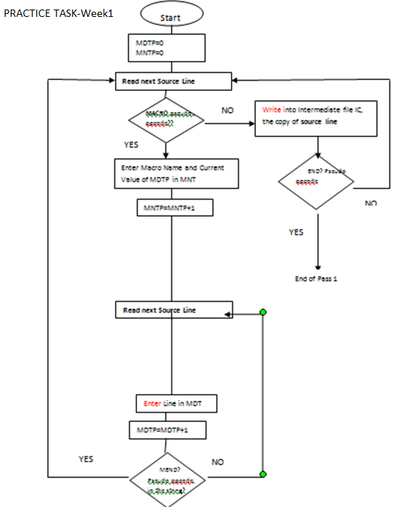

Slide 9
A2: WEEK2 - Sample 1
(Input has macro with parameters, and nested calls- upto 1 level only)

Slide 10
A2: WEEK2 – Task
Given an input file (Next slide)
Perform Pass – I on the given file, by Scanning it and correctly filling the
MNT
MDT
Intermediate Code(IC) (output file)
Print the above 3 things generated - MNT, MDT and the Output File IC

Slide 11
Assign2-Week2 : Sample 1 With NESTED MACRO CALLS
//INPUT FILE –Ass2- Week1
MACRO INCR &A,&B,&REG=CREG
MOVER &REG,&A
ADDS1 &A,&B
MOVEM &REG,&A
MEND
MACRO ADDS1 &C,&D
MOVER AREG, &C
ADD AREG, &D
MOVEM AREG, &D
WRITE &D
MEND
MACRO SUBS1 &C1,&D1
MOVER BREG, &C1
SUB BREG, &D1
MOVEM BREG, &D1
WRITE &D1
MEND
START 200
READ N1
READ N2
ADDS1 N1,N2
SUBS1 N1,N2
READ N1
READ N2
INCR N3,N4,DREG
STOP
N1 DS 2
N2 DS 2
N3 DS 2
N4 DS 2
END
PASS1 – Input-Output
PASS1 TASK
STORE the MACROS in MNT, MDT, generate IC
MDT
INCR &A,&B,&REG=CREG
MOVER #2, #0
ADDS1 #0, #1
MOVEM #2, #0
MEND
ADDS1 &C,&D
MOVER AREG, #0
ADD AREG, #1
MOVEM AREG, #1
WRITE #1
MEND
SUBS1 &C1,&D1
MOVER BREG, #0
SUB BREG, #1
MOVEM BREG, #1
MOVEM BREG, #1
MEND
0
1
2
3
4
5
6
7
8
9
10
11
12
13
14
15
16
MNT
Macro Name | MDT Pointer
INCR | 0
ADDS1 | 5
SUBS1 | 11
0
1
2
0
1
2
&A
&B
REG
START 200
READ N1
READ N2
ADDS1 N1,N2
SUBS1 N1,N2
READ N1
READ N2
INCR N3,N4,DREG
STOP
N1 DS 2
N2 DS 2
N3 DS 2
N4 DS 2
END

Slide 12
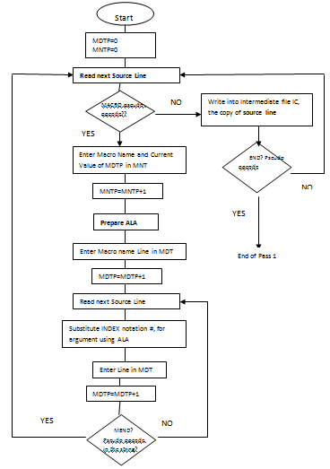
Flowchart of PASS-I of Macro processor

Slide 13
A2: WEEK3 - Sample 2

Slide 14
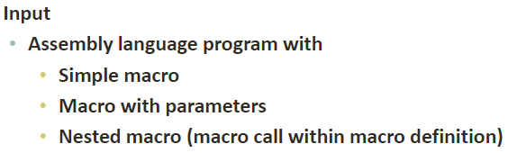
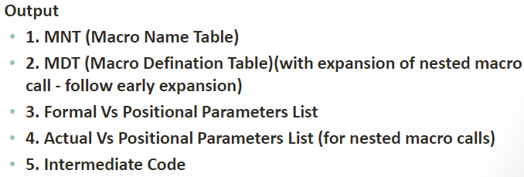
Sample 2 - requirements

Slide 15
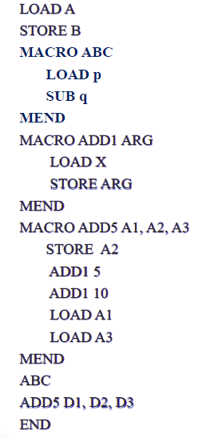
Sample2 Input

Slide 16
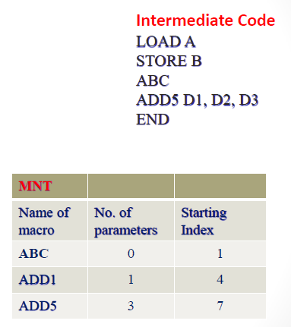
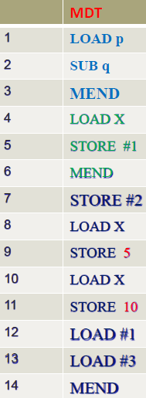
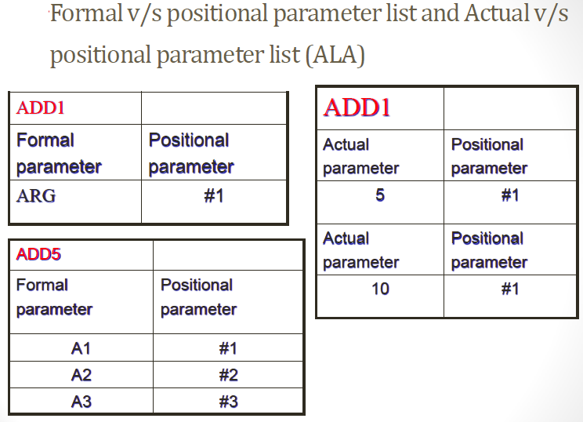
Sample 2 : Input- Output

Slide 17
Thank you!!
Submission:
Batch : C2-C3: Create 1 doc file with code + screenshot and submit on LPCC Lab VOLP when asked to.

